Slide 1
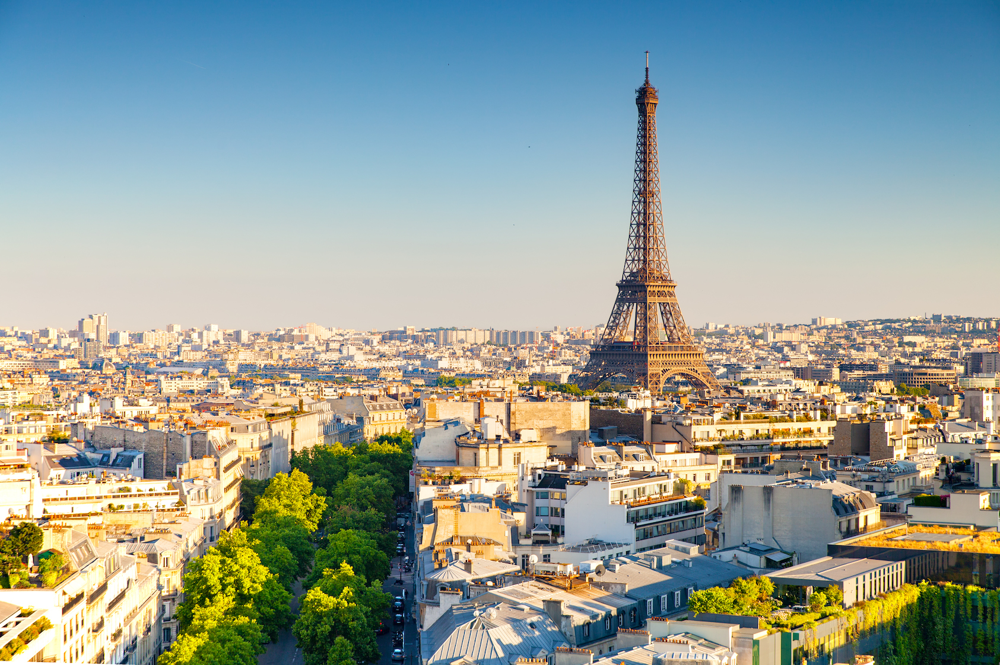
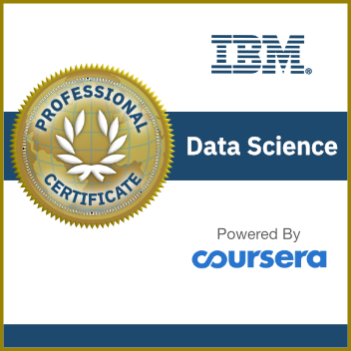

IBM CAPSTONE PROJECT The Battle of Neighborhoods:
Cluster Analysis of Paris : Seafood restaurant
Mohammed Bouayoun

Slide 2

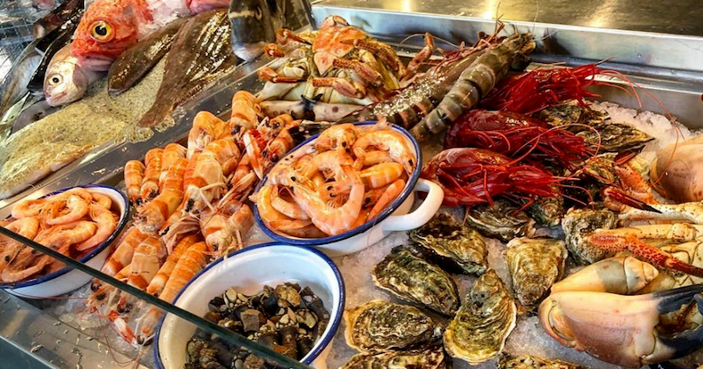
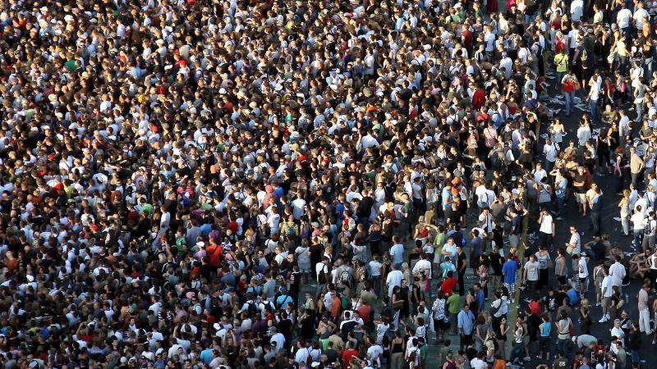
Business Problem
The closest sea to Paris is 194 km away, it’s necessary to be close to the fish shops to get fresh fish for our new restaurant.
What are the demographic trends in the neighborhood ?
What are the characteristics of the individuals frequenting the neighborhood (residents, transients, employees, workers…)? Age, sex, activity, purchasing power, intentions, behavior ?

Slide 3

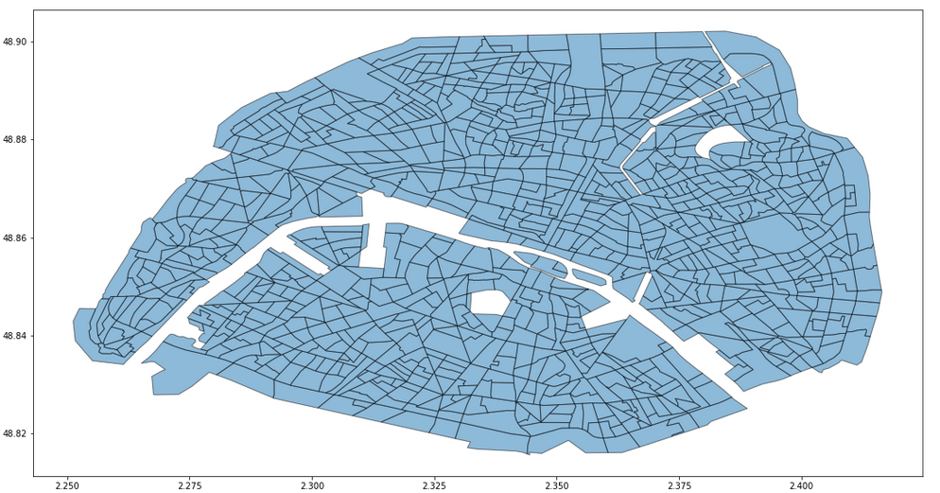

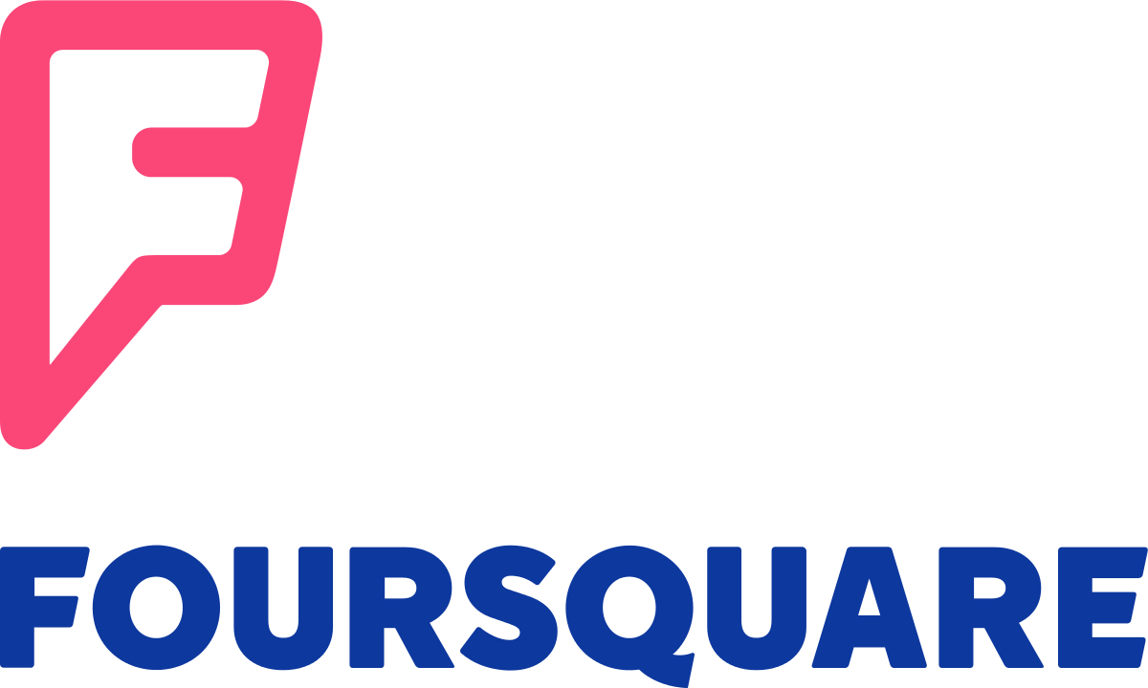

Data
INSEE had developed a division of the territory into homogenously sized grids called IRIS2000. This acronym stood for “Ilots Regrouped for Statistical Information” and referred to the target size of 2,000 inhabitants per elementary grid cell.
Density population
Foursquare API to explore neighborhoods in PARIS and seafood restaurant.
GoogleMap for fish shop

Slide 4
Methodology and Analysis
1
Download the IRIS dataset
6
Merge cleaned IRIS dataset with seafoods restaurant
2
Clean the IRIS dataset
7
Segment neighborhoods using k-means clustering to locate seafood restaurant
3
Analyze the IRIS dataset
8
Overlay clusters with restaurants, fish shops and activity people
4
Visualize the IRIS dataset
9
Take places that are far from restaurants and near to fish shops according to the density of the people
5
Utilize the Foursquare API to explore the neighborhoods and seafood restaurant in Paris

Slide 5
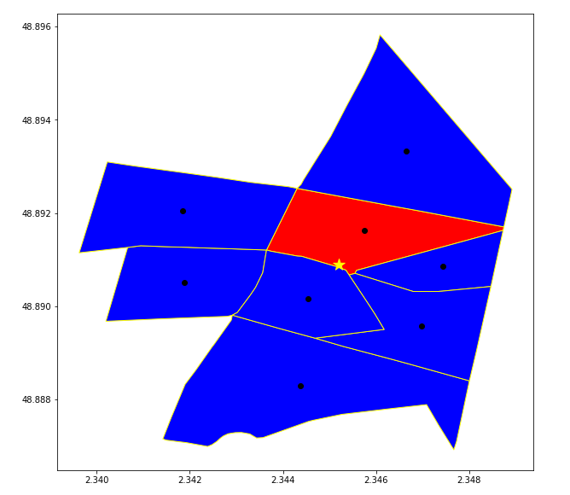
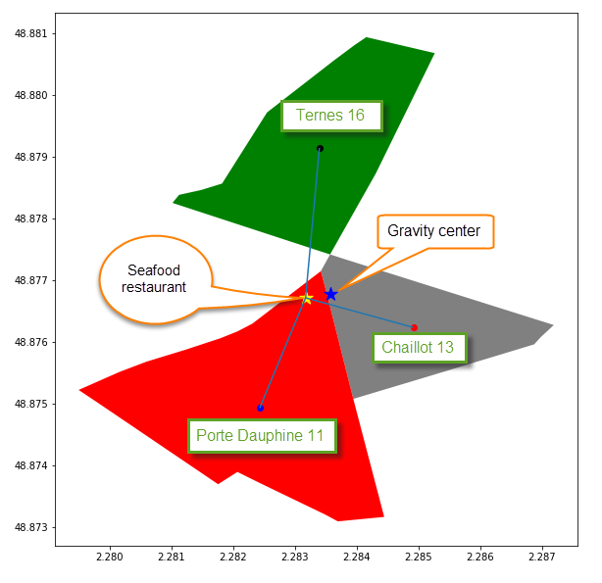
Methodology and Analysis : Foursquare API
Looking for a group of venues in 160 meters distance of each of the neighborhood
A seafood restaurant can be between several polygon, we only keep the polygon where it belongs.
Some restaurants are located between 8 polygons

Slide 6
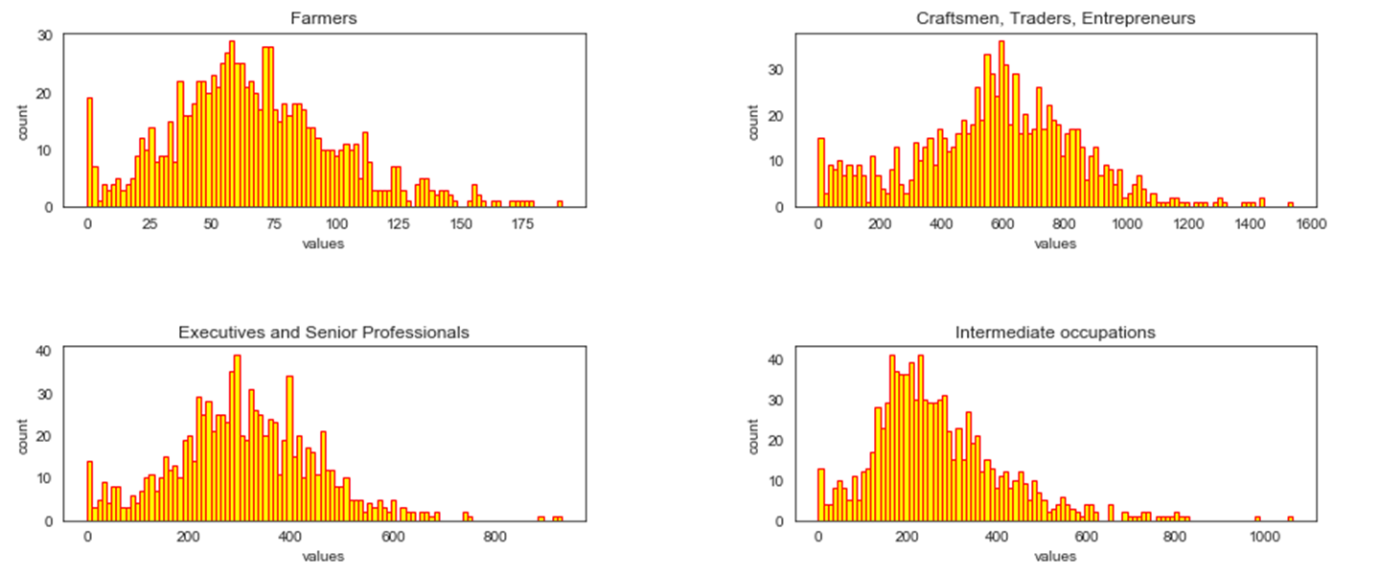
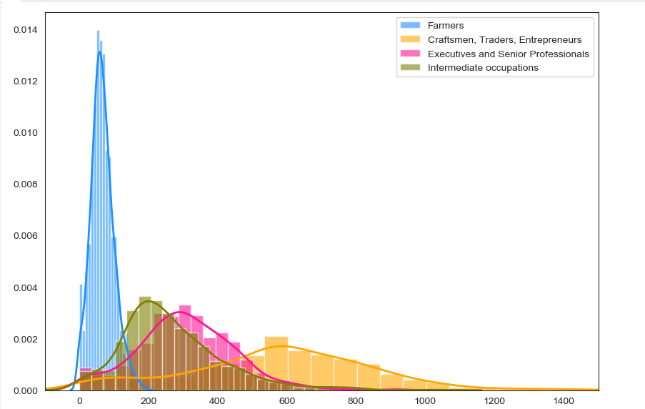
Methodology and Analysis : Population density
The histogram almost follows a normal distribution law flattened to the right.

Slide 7
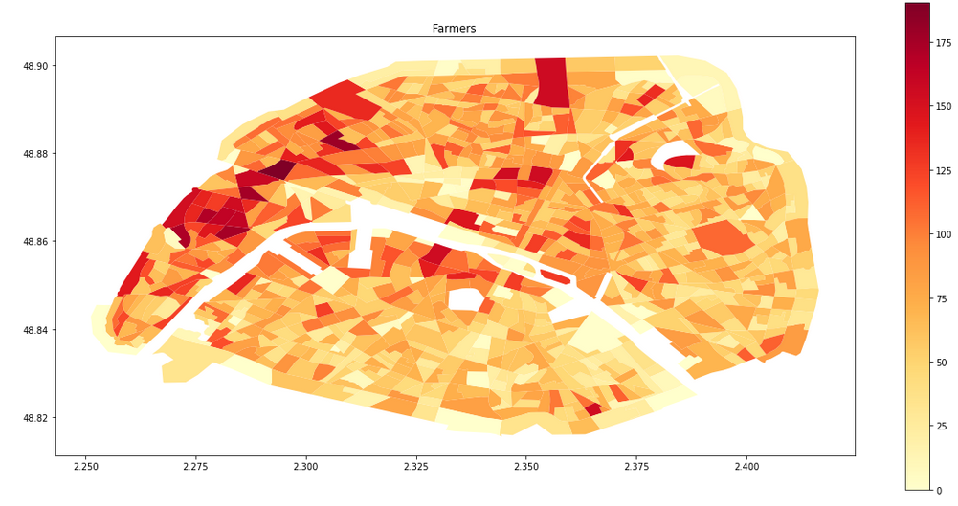
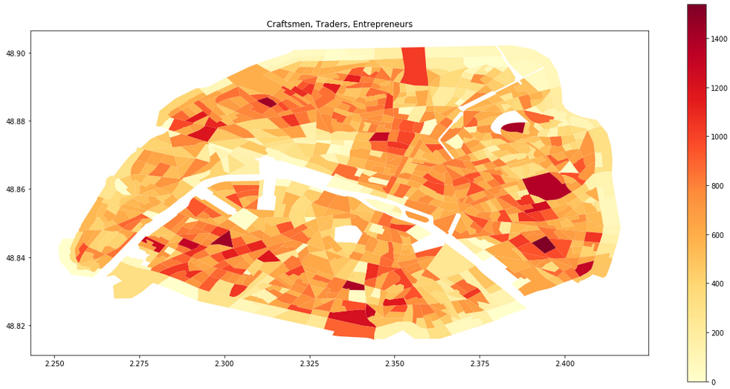
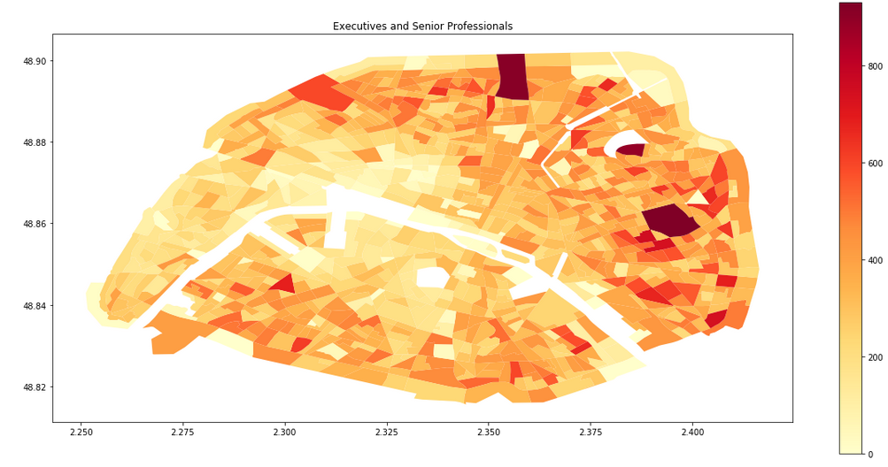
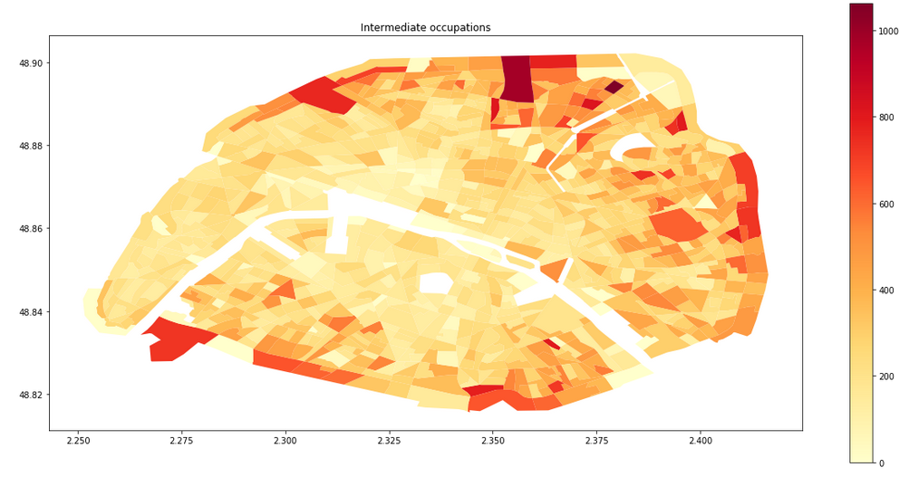
Mathodology and Analysis : population densisty

Slide 8
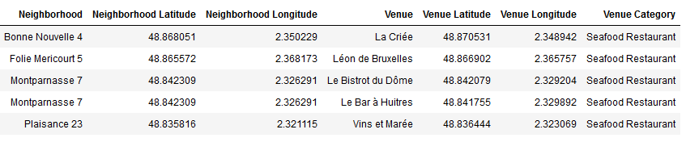
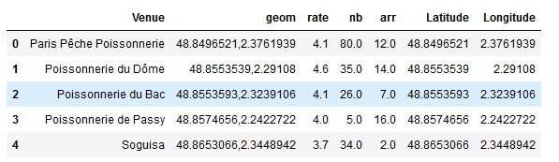
Methodology and Analysis : Seafood Restaurant and fish shop
Use Foursquare API to get information about some venues around these seafood restaurant
Use the csv file fishs_paris to get information about fish shop in Paris
Venue : name of fish shop
Rate : rating
Nb : number of rating
Arr : Paris region

Slide 9
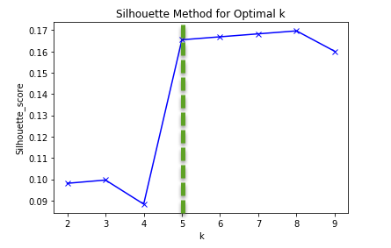
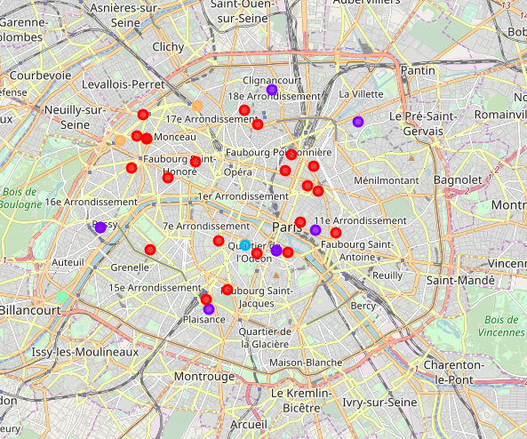
Methodology and Analysis : K-Means
With silhouette Method I choose 5 as number of cluster

Slide 10
Results and Discussion

Slide 13
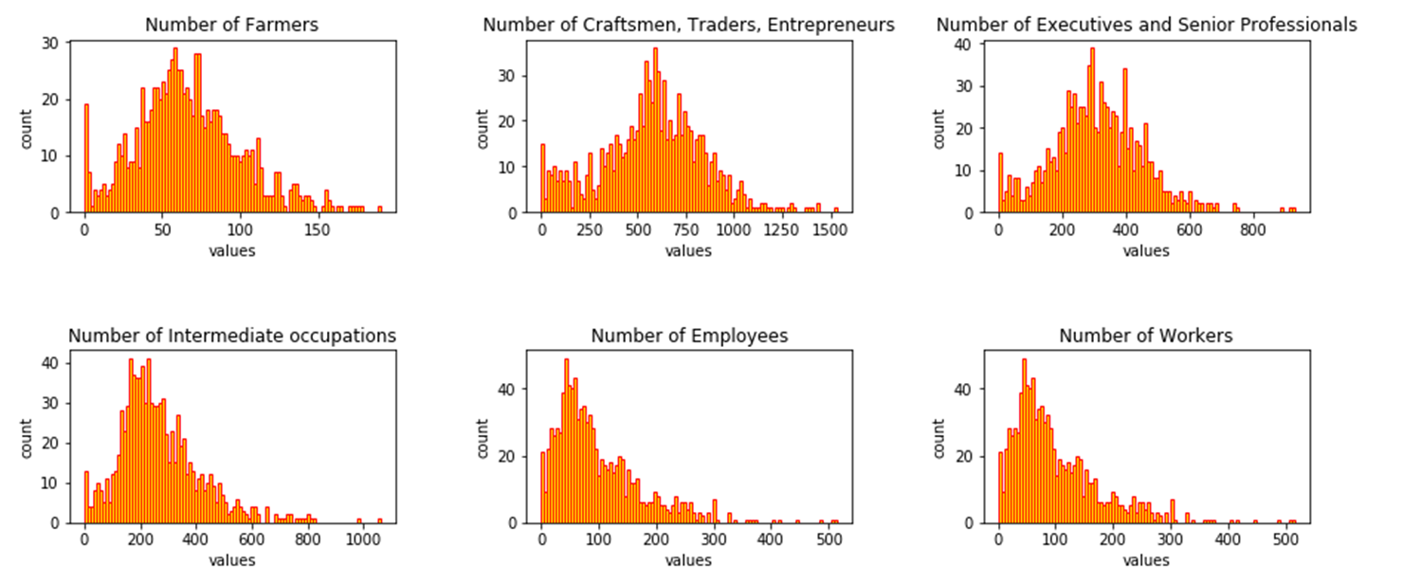

Slide 14
Result

Slide 15
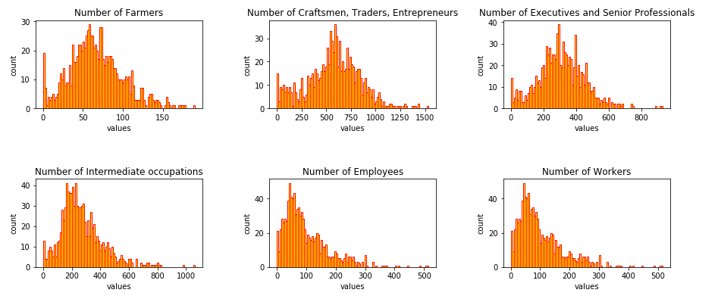
Discussion

Slide 16

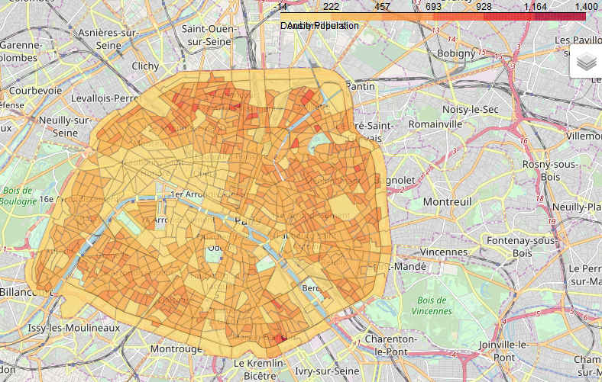
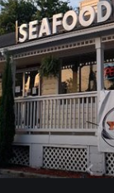
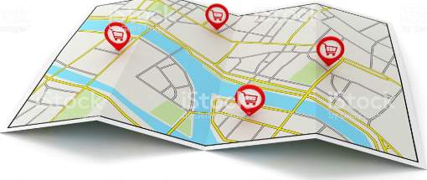
Conclusion

